Slide 1
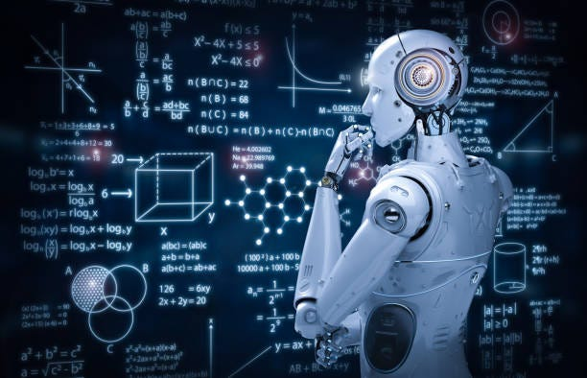
Title: Modern Science and Technology Subtitle: Shaping the Future Presented by: [Rima] Date: [18.05.2025]

Slide 2
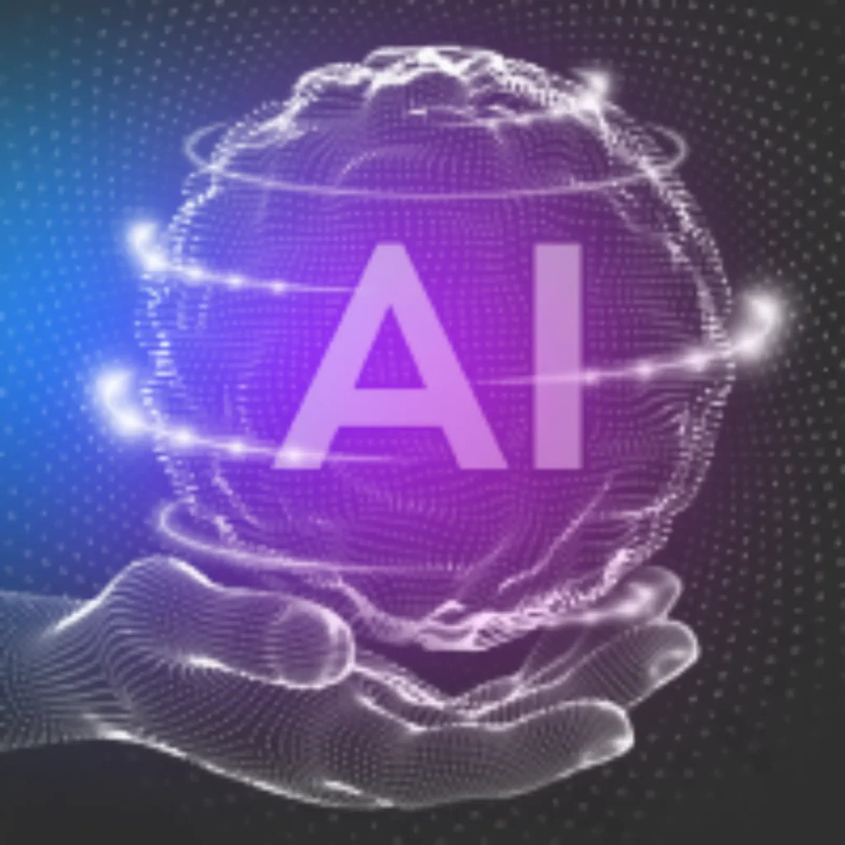
Introduction;
Definition of science and technology
Importance in modern life
How they influence each other

Slide 3
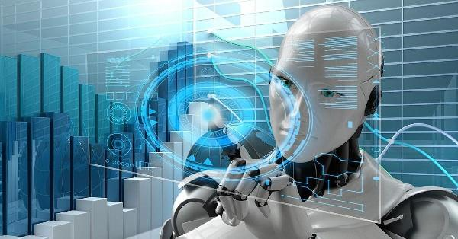
Key Areas of Modern Science;
Artificial Intelligence (AI)
Genetic Engineering
Quantum Physics
Space Science

Slide 4

Key Areas of Modern Technology;
Internet of Things (IoT)
5G and communication technology
Robotics and Automation
Renewable Energy Technologies

Slide 5
Conclusion;
Recap of major points
The role of responsible innovation
Encouragement to explore and contribute

